Slide 1
Employee Salary Prediction Using Random Forest
CAPSTONE PROJECT
Presented By:
Name:- Sanskar Saurabh
College:- K.R. Mangalam University
Department:- MCA
AICTE-ID:- STU65b7896ea4f981706527086

Slide 2
OUTLINE
Problem Statement (Should not include solution)
System Development Approach (Technology Used)
Algorithm & Deployment (Step by Step Procedure)
Result
Conclusion
Future Scope(Optonal)
References

Slide 3
Problem Statement
In many organizations, understanding employee income patterns helps with better workforce planning and decision-making. However, employee data is often complex and filled with mixed types of information like age, education, job type, and marital status. This project aims to predict whether an employee earns more or less than ₹50,000 using machine learning models trained on such structured data. By building a user-friendly web app, HR teams can easily upload employee records and receive instant income classification results. This not only improves hiring and compensation strategies but also enables data-driven insights into workforce demographics.

Slide 4
System Approach
The "System Approach" section outlines the overall strategy and methodology for developing and implementing. Here's a suggested structure for this section:
System requirements
To run and deploy the machine learning application smoothly, the following system configuration is recommended:
Operating System: Windows 10 / Linux / macOS
Processor: Intel i5 or above
RAM: Minimum 8 GB
Storage: At least 1 GB free disk space
Internet Connection: Required for Streamlit deployment

Slide 5
System Approach
Library required to build the model
The project uses several open-source Python libraries essential for data preprocessing, visualization, model training, and deployment:
Pandas:- For Data Manipulation
Numpy:- For Numerical Operation
Scikit-learn:- For Building and Evaluating Machine Learning Model
Matplotlib & Seaborn:- for data visualization

Slide 6
Algorithm & Deployment
Imported Required Libraries
Begin by importing essential libraries such as pandas, numpy, scikit-learn, seaborn, matplotlib, and streamlit.
Load and Inspect the Dataset
Uploaded the employee CSV file and using pandas to read the data. Display the first few rows to understand the structure and types of data.

Slide 7
Algorithm & Deployment
Preprocessing the Data
Rename columns to a consistent format.
Strip whitespace and handle missing values.
Encode categorical variables using LabelEncoder.
Split the Data
Separate the dataset into features (X) and target (y). Then, split them into training and testing sets using train_test_split.

Slide 8
Algorithm & Deployment
Train Machine Learning Models
Applying different classification algorithms such as:
Random Forest Classifier
Logistic Regression
Decision Tree
Support Vector Machine (SVM)
Evaluating Model Performance
Measure performance using accuracy, confusion matrix, and classification report to choose the best model.

Slide 9
Algorithm & Deployment
Builded Interactive Web App Using Streamlit
Created a user-friendly dashboard where users can upload their data and get instant predictions.
Deployed the Application on Streamlit Cloud
Pushed the code to GitHub and deploy the app through Streamlit Cloud, making it accessible to users anywhere.

Slide 10
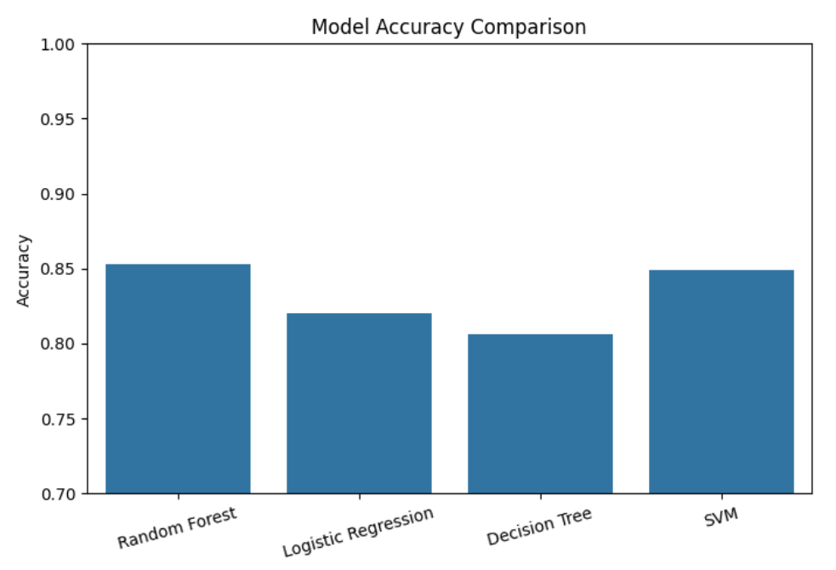
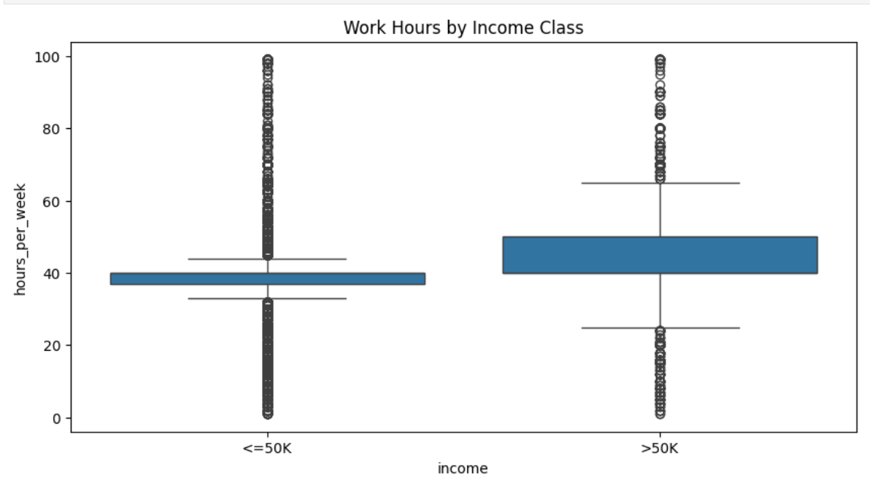
Result

Slide 11
Result
The machine learning models were successfully trained on the cleaned employee dataset to classify whether an individual earns more or less than ₹50,000. Among the models tested—Random Forest, Logistic Regression, Decision Tree, and SVM—the Random Forest Classifier consistently achieved the highest accuracy and performance metrics.
The Best Model Delivered an accuracy of over 85% on the test data.

Slide 12
Result
Streamlit Application Link:- https://appempsalaryprediction-6unpvmkgenbo3nmyjrhjtr.streamlit.app/
Github Link 1:- https://github.com/SanskarSaurabh/IBM_Edunet_Internship_Project_Employee_Salary_Prediction/blob/main/Employee%20Salary%20Prediction%20Project/ESP.ipynb
Github Link 2:-
https://github.com/SanskarSaurabh/Streamlit_Emp_Salary_Prediction/blob/main/app.py

Slide 13
Conclusion
This project successfully demonstrated how machine learning can be applied to classify employee income levels based on demographic and professional attributes. By using models like Random Forest, Logistic Regression, Decision Tree, and SVM, we achieved high accuracy, with Random Forest performing the best overall. The Streamlit web application provided a simple and interactive interface for data upload, model selection, and results visualization, making the solution user-friendly.
Challenges Encountered:
Handling missing or inconsistent data entries required careful preprocessing.
Encoding multiple categorical features while avoiding data leakage was critical.
Ensuring compatibility with Streamlit deployment required clean and structured Python code.

Slide 14
Future scope(Optional)
While the current system effectively classifies employee income using machine learning models, there are several opportunities for enhancement and expansion in the future:
Real-time Prediction Interface: Allow users to input individual employee details via form fields instead of uploading a CSV.
Database Integration: Connect the app to a backend database (like MongoDB or PostgreSQL) to store and retrieve historical predictions.

Slide 15
References
https://www.w3schools.com/python/python_ml_logistic_regression.asp
https://docs.streamlit.io/
https://scikit-learn.org/stable/
https://pandas.pydata.org/docs/
https://seaborn.pydata.org/
https://matplotlib.org/stable/contents.html

Slide 16
THANK YOU

